Slide 1

Athena Software Group
ASG Cyber LLM Specs [Glaukopis]

Slide 2


Glaukopis (γλαυκῶπις) the “grey eyed one”

Slide 3

01
Mission Statement
02
Market Opportunity
ASG Overview
03
Who we are and what we do
04
Products & Services
05
Leadership Team
06
Financial Model

Slide 4
Who we are what we do
Athena Software Group brings together some of the best minds in computer science, cyber defense and SaaS to design solutions specifically for application service providers to provide a single, integrated, intuitive cyber defense system that spans the entire application, system and network ecosystem within which the application resides, facilitating better, faster and more informed outcomes with respect to threat and anomaly detection, response management, vulnerability management and compliance.

Slide 5
Athena Mission Statement
To provide enterprise application providers with a fully integrated and best in class set of tools for application security, availability and compliance.

Slide 6
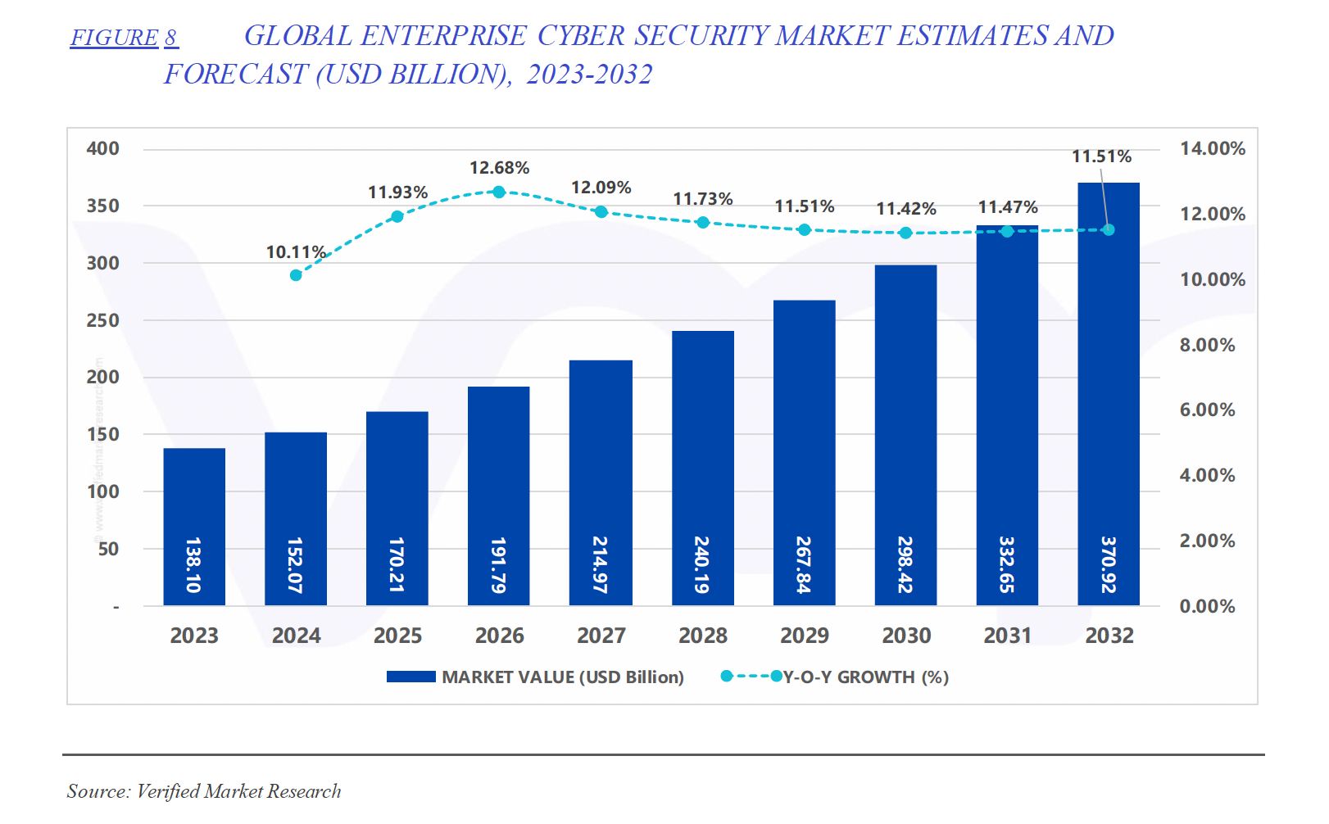
Market Opportunity
Cost of breaches continues to soar, as does Cyber Insurance costs, driving up spend on Cyber Security
LLM adoption in Cyber is just getting started. Bad actors are getting more sophisticated, leveraging AI technologies, platforms distribution models
Compliance continues to become more complex as the legislative landscape continues to evolve both in the US at the federal and state levels and in the EU, UK, ASPAC

Slide 7
CyberPal.AI (IBM)
SecKnowledge is a domain-knowledge-driven cyber-security instruction dataset, meticulously designed using years of accumulated expert knowledge in the domain through a multi-phase generation process
Base Model: Open-source LLMs (specific base model not specified).​
Training Methodology:
  Instruction Tuning: Utilizes SecKnowledge dataset, created through a two-step process involving expert-defined schemas and hybrid synthetic content generation.​
  SecKnowledge: A domain-specific instruction dataset encompassing various cybersecurity topics.
  SecKnowledge-Eval: An evaluation suite designed to assess LLMs on complex cybersecurity tasks.​
Benchmark Performance:
  Training-Aligned Tasks: Up to 24% improvement over baseline models.
  Public Cybersecurity Benchmarks: Up to 10% improvement.
  Specific Task Improvements:
    CTI Detection and Mitigation: Up to 26% improvement.
    SIEM Rule TTP Mapping: Up to 17% improvement.
    CWE Summarization: Up to 35% improvement.
    CWE Technical Impact Mapping: Up to 11% improvement.
Levi, Matan et al. “CyberPal.AI: Empowering LLMs with Expert-Driven Cybersecurity Instructions.” ArXiv abs/2408.09304 (Aug. 2024): https://doi.org/10.48550/arXiv.2408.09304

Slide 8
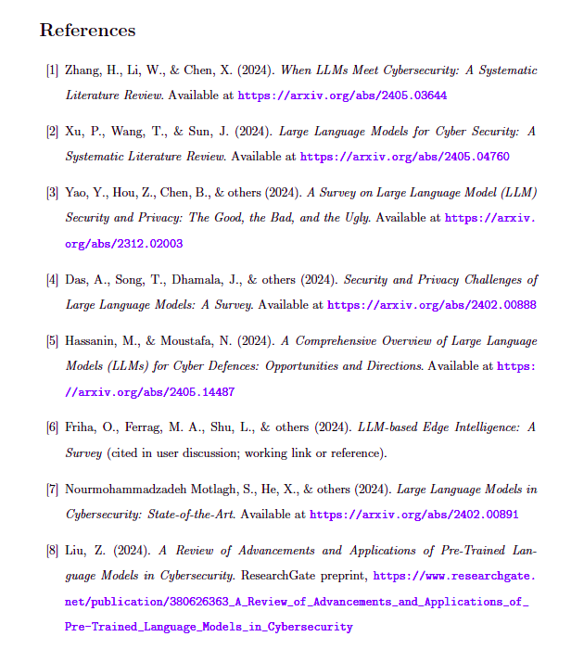
Survey Research Literature in Cyber Security

Slide 9

Athena Software Group
Best in Class, AI Enabled, security solutions for Enterprise application providers.

